Slide 1
Database Systems
AICT005-4-1-Database Systems (version1)
Week 1: Introduction to Database

Slide 2
Topic & Structure of The Lesson
Data vs Information
Database vs DBMS
Types of database

Slide 3
Learning Outcomes
At the end of this topic, You should be able to
Explain the difference between data and information
Describe the difference between database and DBMS
State different types of database

Slide 4
Key Terms You Must Be Able To Use
If you have mastered this topic, you should be able to use the following terms correctly in your assignments and exams:
Data
Infromation
Database
Database Management System

Slide 5
In this chapter, you will learn:
The difference between data and information
What a database is, what the different types of databases are, and why they are valuable assets for decision making
The importance of database design
How modern databases evolved from file systems

Slide 6
In this chapter, you will learn (continued):
About flaws in file system data management
What the database system’s main components are and how a database system differs from a file system
The main functions of a database management system (DBMS)

Slide 7
Data vs. Information
Data:
Raw facts; building blocks of information
Unprocessed information
Information:
Data processed to reveal meaning
Accurate, relevant, and timely information is key to good decision making
Good decision making is the key to survival in a global environment

Slide 8
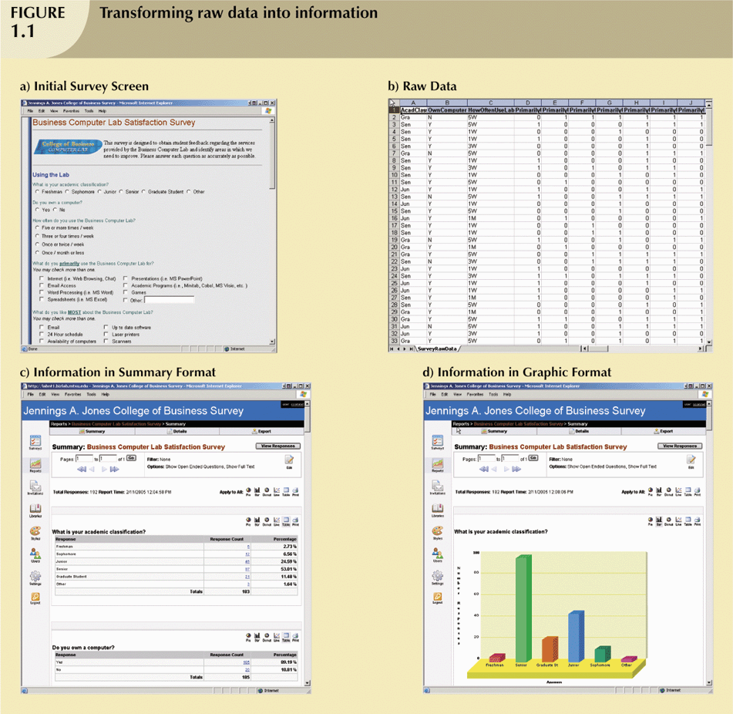
Transforming Raw Data into Information

Slide 9
Transforming Raw Data into Information (continued)

Slide 10
Transforming Raw Data into Information (continued)

Slide 11
Transforming Raw Data into Information (continued)

Slide 12
Introducing the Database and the DBMS
Database—shared, integrated computer structure that stores:
End user data (raw facts)
Metadata (data about data)

Slide 13
Introducing the Database and the DBMS (continued)
DBMS (database management system):
Collection of programs that manages database structure and controls access to data
Possible to share data among multiple applications or users
Makes data management more efficient and effective

Slide 14
Role and Advantages of the DBMS (continued)
End users have better access to more and better-managed data
Promotes integrated view of organization’s operations
Probability of data inconsistency is greatly reduced
Possible to produce quick answers to ad hoc queries

Slide 15
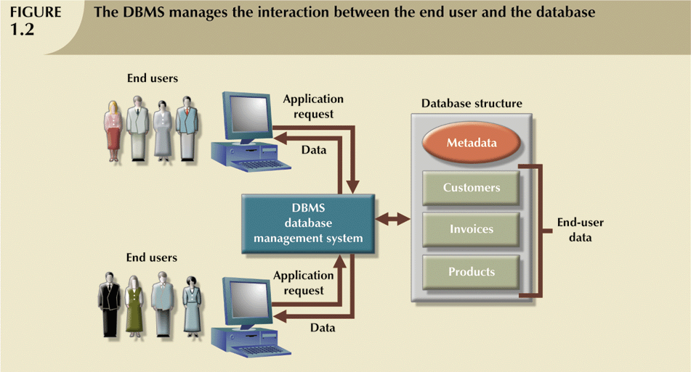
Role and Advantages of the DBMS (continued)

Slide 16
Types of Databases
Single-user:
Supports only one user at a time
Desktop:
Single-user database running on a personal computer
Multi-user:
Supports multiple users at the same time

Slide 17
Types of Databases (continued)
Workgroup:
Multi-user database that supports a small group of users or a single department
Enterprise:
Multi-user database that supports a large group of users or an entire organization

Slide 18
Types of Databases (continued)
Can be classified by location:
Centralized:
Supports data located at a single site
Distributed:
Supports data distributed across several sites

Slide 19
Types of Databases (continued)
Can be classified by use:
Transactional (or production):
Supports a company’s day-to-day operations
Data warehouse:
Stores data used to generate information required to make tactical or strategic decisions
Often used to store historical data
Structure is quite different

Slide 20
Quick Review Question
What is the difference between data and information
Describe the difference between database and DBMS
Briefly explain 3 types of database
What are the advantages of DBMS

Slide 21
Summary of Main Teaching Points
Data are raw facts, information is processed data to reveal meaning
Database store shared, integrated data.
DBMS is a collection of programs that manages database structure and controls access to data.
Database can be classified by usage or location

Slide 22
Question and Answer Session
Q & A

Slide 23
What we will cover next
File System and its problems
DBMS functions

